Slide 1
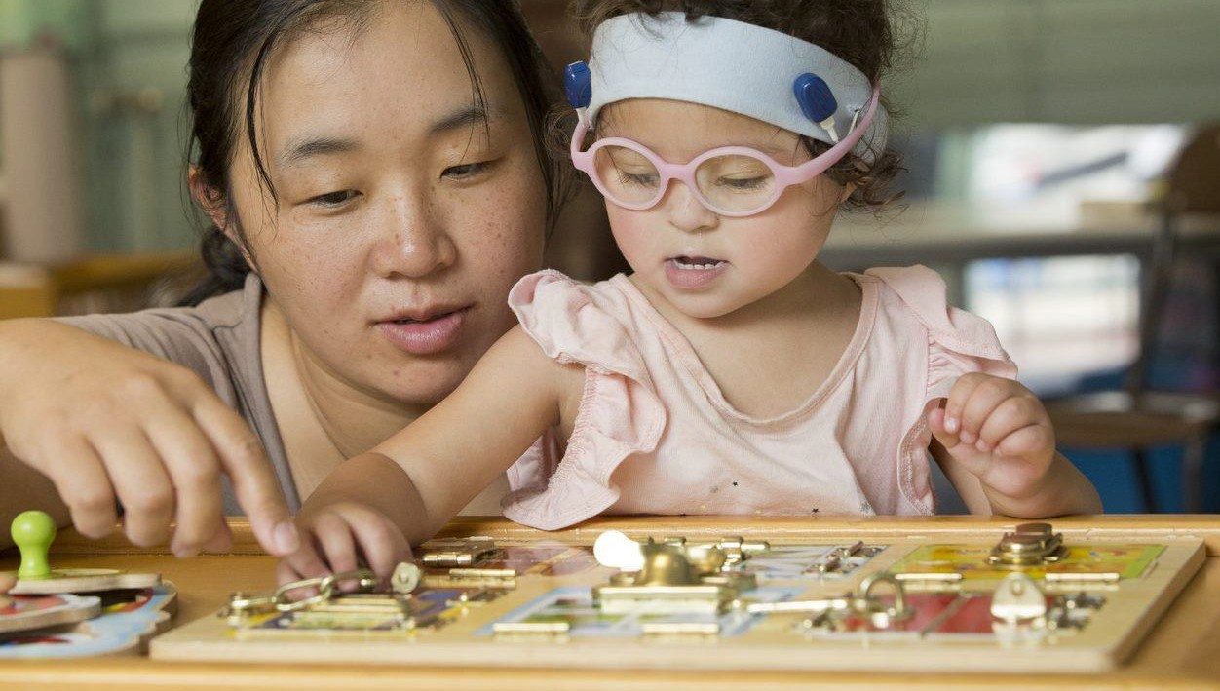
The Champion Centre
GoodMeasure results 15/11/2021

Slide 2
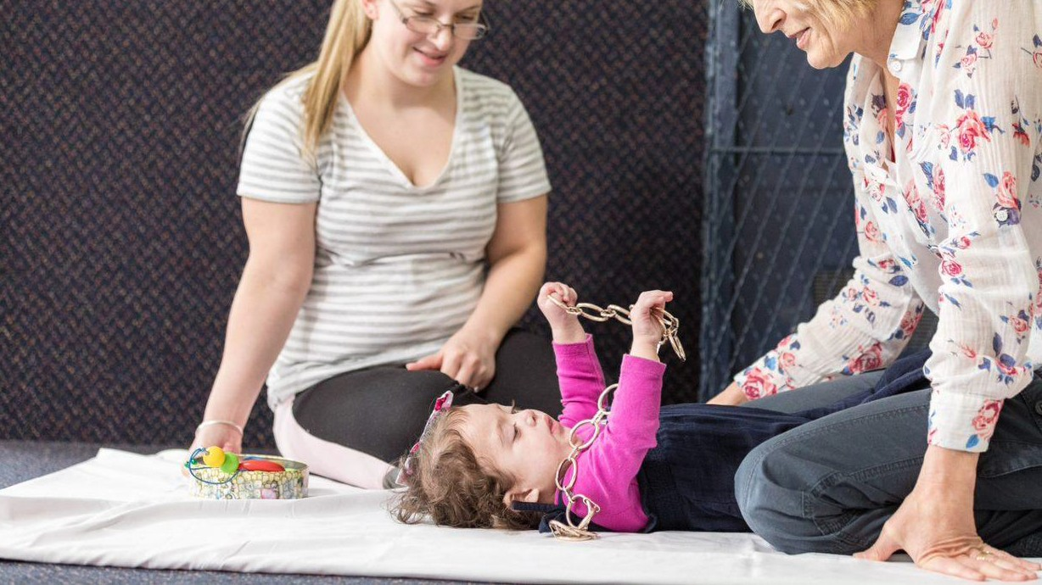
Helping children live fulfilled lives:
every child has the human right to develop their potential whatever their learning challenges, medical challenges or family circumstances
children who have such challenges deserve the highest standard of evidence- based professional practice.

Slide 3
Scope for this GoodMeasure
Programme streams | Description
Early intervention programme | Multi-disciplinary early intervention services to infants and young children with significant disabilities and their families in Canterbury
Exclusions and notes
One year of data used with children divided into age bands Monitoring programmeis excluded

Slide 4
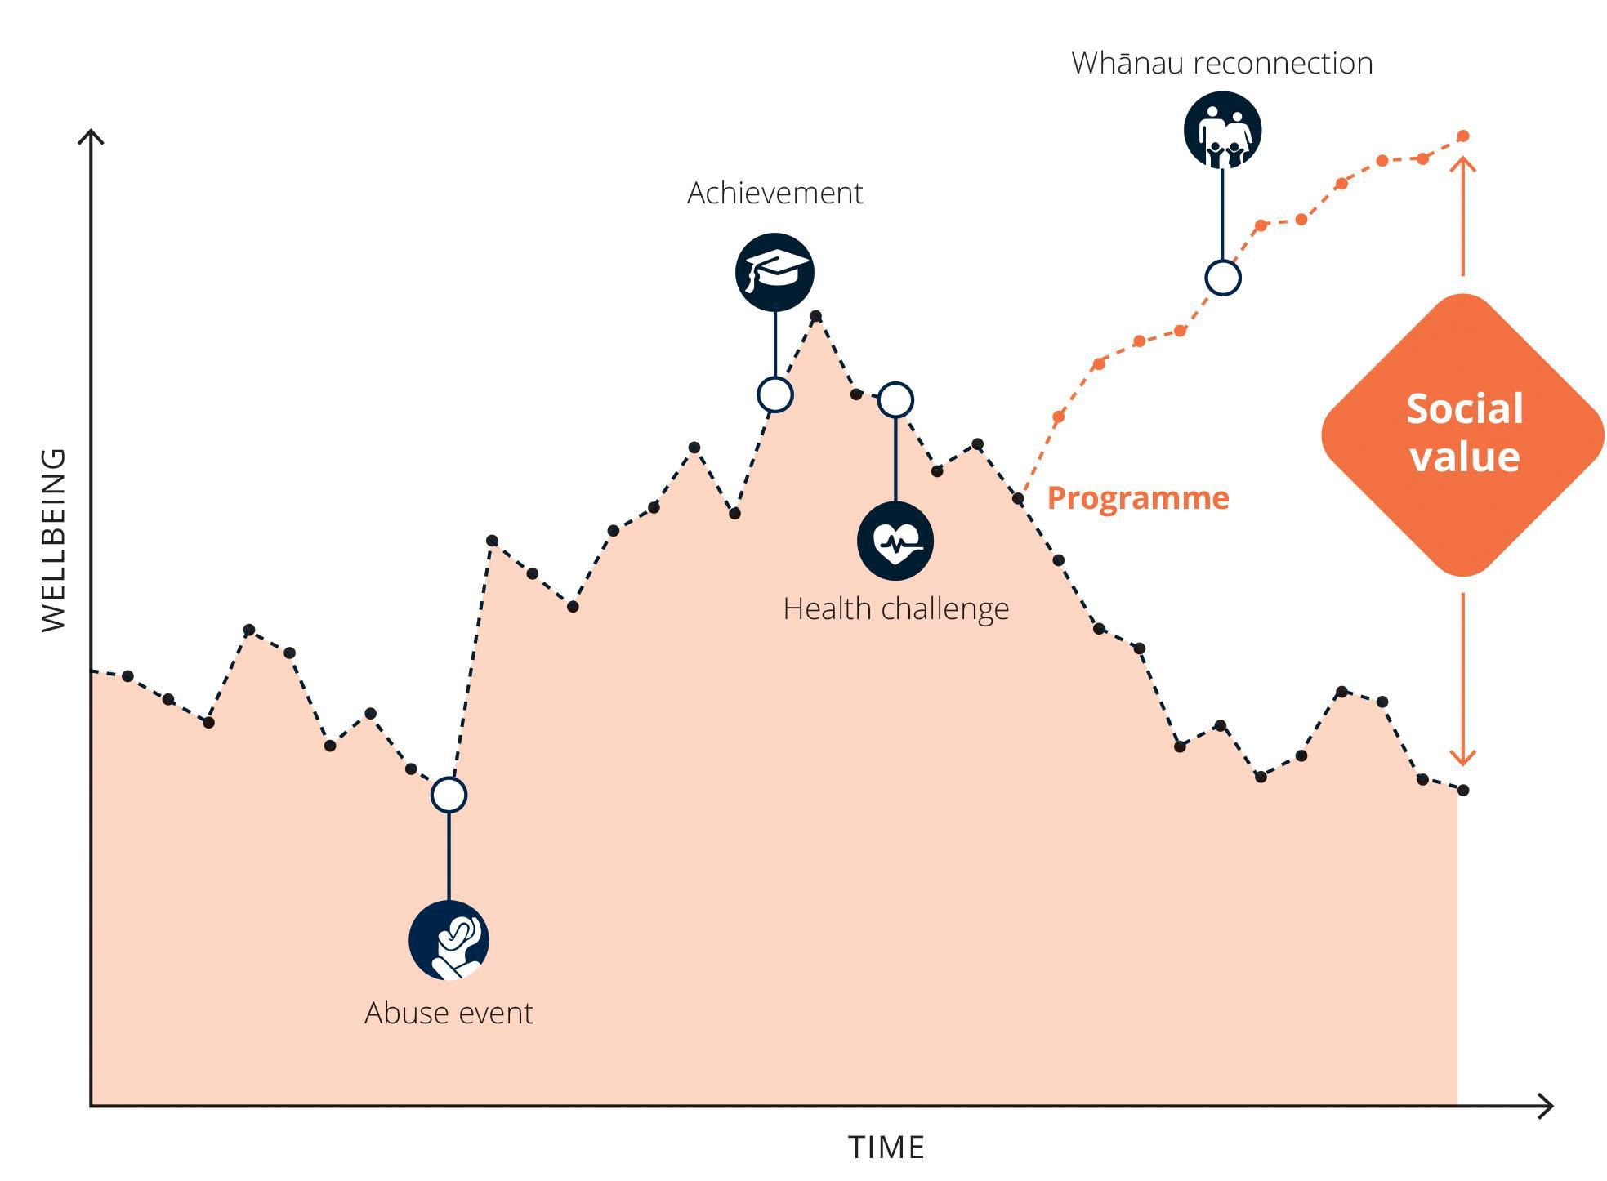
How ImpactLab measures social value

Slide 5
What positive long- term changes in peoples’ lives does this programme help to create?
How effective do we expect the programme to be at creating those changes, based on the available evidence?
Who does the programme serve, and what is the opportunity to make a difference for those people?
How many people does the programme reach, and how many people engage long enough to meaningfully benefit?
Impact
Effectiveness
Opportunity
Population
Social
value

Slide 6
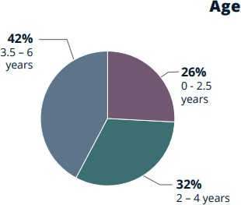
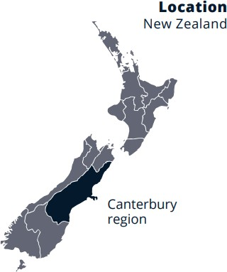
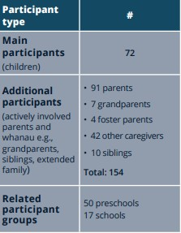
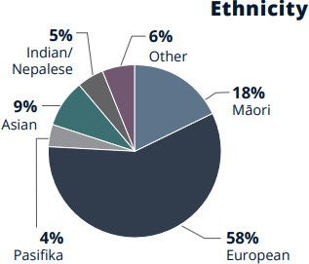
Population
Age
Ethnicity
Condition/diagnosis
6%
High risk prematurity
29%
Global Development
Delay
28%
Down syndrome
Average contact time per child per year:
244 hours over 40 weeks
25%
Genetic condition
13%
Brain injury

Slide 7
Change journey
Programme entry and relationship building | Tailored clinical care | Advocacy and additional support
Children are referred by the Early Intervention Coordination Service in Canterbury. A social worker visits families in their home. Parents share their stories and priorities, and learn about what to expect when they come into the Centre. The home visit also enables Champion Centre to assess and establish the individual needs of children and parents in order to provide tailored support. The same staff member who visited the home supports families in their first visits to the Centre. | Planning Parents and children meet with Champion Centre twice a year to create and reshape personalised plans. Tailored support is offered across three age stages: babies (age 0-2), middle years (age 2-4) and transition to school (age 5-6). At key transition points the child’s plan is reviewed. Weekly Intervention: Children and their parents receive weekly centre- based learning interventions delivered by expert staff. Most children receive three hours of intervention per week, in a group of 5-6 other children of a similar age and/or with similar developmental needs. For example, children with Down Syndrome, Motoric or Sensory challenges may work with staff with specialist skills in these areas. Children in the Relating and Communicating stream receive one hour of 1:1 intervention. Transition to School: Children are supported at their preschool, with information and support also provided to preschool teachers. Champion Centre supports parents and children through their child’s transition to school including planning, face to face meetings and school visits. | The programme also directly provides parents and children with a range of additional supports where needed, including: Family Support Services: emotional support through in-home and face to face sessions, and advocacy for referral or access to third party support services (e.g., financial, housing). Equipment: provision of required specialised equipment for the home and classroom. ORS funding: enables parents to apply for financial assistance from the Ongoing Resourcing Scheme (ORS). Feeding Programme: one-on-one feeding support to children and families either in-home or in-centre. Psychological support: in-home and in-centre support to address complex interpersonal or relationship issues that require ongoing assistance. Early Intervention Educators (Education Support Workers): one-on-one support to children from age 3 years in their community early childhood centre. Weekly hours range from 3-9 hours. This supports inclusion for children and helps skills to be generalised within the community.

Slide 8
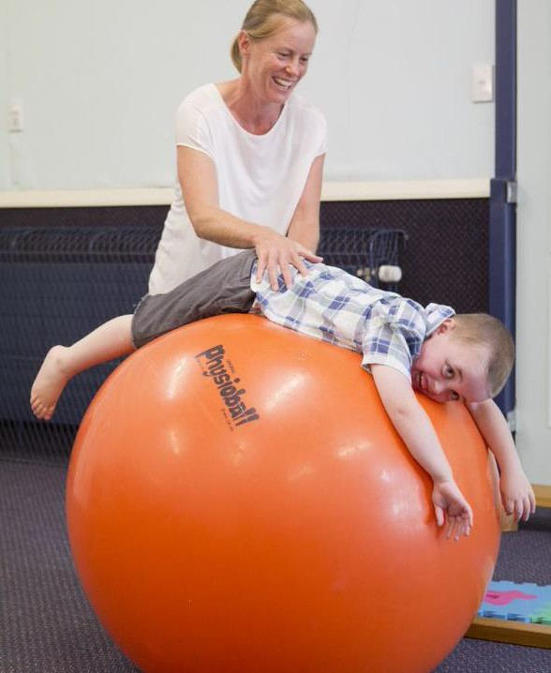
Investment and completion
Total investment |  | $2,277,118
Direct costs Indirect costs |  | 73% 27%
Total cost per participant starting* |  | $31,627
*Cost per person reflects the cost per child only
Total completion rate |  | 97%
Completion definition: transitioning to school with exiting prior to completion e.g., shifting to another service or relocating Note: social value is only counted per completing participant

Slide 9
Impact
GoodMeasure outcomes |  | Additional outcomes
These outcomes contribute directly to this year’s SROI |  | These outcomes do not contribute directly to this year’s SROI
All children Improve physical health Improve infant safety (babies only) Increase academic achievement Reduce family violence Reduce child placement Children in middle years and transition to school Increase employment Reduce addiction Reduce offending Reduce risky behaviour Families Improve mental health Improve housing (Kainga Ora referral) Reduce asthma (Kainga Ora referral) |  | Increase social connectedness Increase family cohesion Increase parental confidence Increase access to financial support (e.g., WINZ) Increase independence and self-advocacy Decrease system navigation costs Reduce loneliness and isolation

Slide 10
Impact
GoodMeasure Outcomes | Definitions
Improve mental health | intrinsic measurement of an improvement in mental health
Improve physical health | intrinsic measurement of an improvement in physical health
Improve housing | Measures cost savings associated with improved housing quality
Improve infant safety | measures hospital costs associated with infant safety
Increase academic achievement | measures increased income and government savings associated with different levels of academic attainment
Improve employment | measures income and government savings associated with moving to employment
Reduce child placement | measures government costs associated with child placement
Reduce family violence | measures government costs associated with family violence
Reduce offending | measures increased income and government savings associated with reduced offending
Reduce risky behaviour | measures government costs associated with risky behaviour
Reduce addiction | measures government costs associated with addiction
Reduce asthma | Measures income and hospital costs associated with asthma

Slide 11
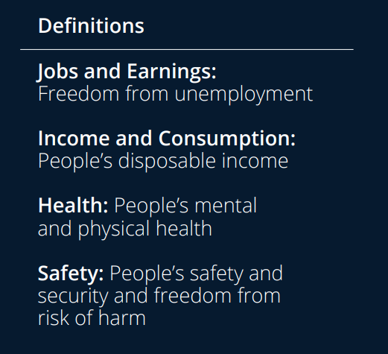
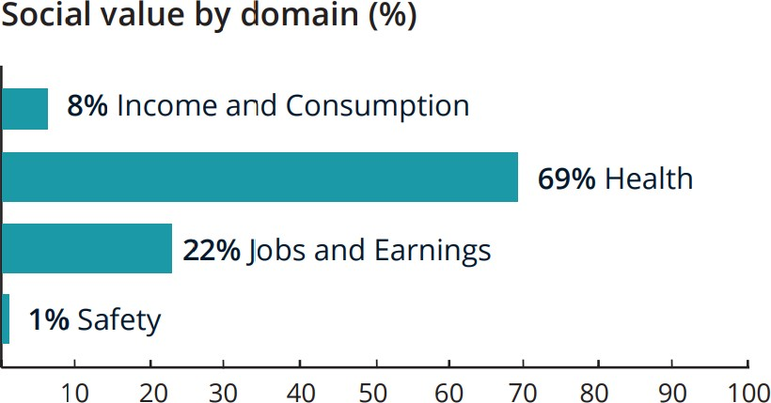
Impact: Living Standards Framework domain breakdown

Slide 12
Effectiveness: GoodFeatures
Structure | The programme ties measurable success indicators to its goals and strategies, with progress regularly evaluated and relevant aspects of service delivery revised accordingly. The programme uses early and intensive intervention to support improved educational and health outcomes for children with disabilities. The programme uses an age-appropriate learning curriculum that provides engaging activities that are designed to achieve clearly defined goals matched to individuals. The programme is delivered by highly trained staff and maintains a small child-to-instructor ratio. The programme supports parents and whānau to navigate and access third-party support services.
Engagement | The programme actively and intensely supports adults to acquire the knowledge and capabilities required to facilitate healthy child development. The programme emphasises the strengths and unique abilities of participants rather than the restrictions of specific learning disabilities. The programme tailors the difficulty of learning tasks to meet the individual needs of students and promote high levels of educational achievement. The programme provides interventions in small groups and an interactive learning environment. The programme provides creative sensory learning experiences and specific educational supports for participants for whom group work is not appropriate. The programme supports parental wellbeing and health by improving emotional regulation through direct provision of or referral to counselling.
Screening | The programme aligns intervention types with the specific risk factors of participants and sub-participants. The programme identifies family stress factors (e.g. information needs, interpersonal, family distress) and then designs and implements their services to mitigate those stress factors. The programme targets identified stress factors by providing resource support, social support, and access to information and services. The programme tailors its services to align with family goals, values, priorities and routine.

Slide 13
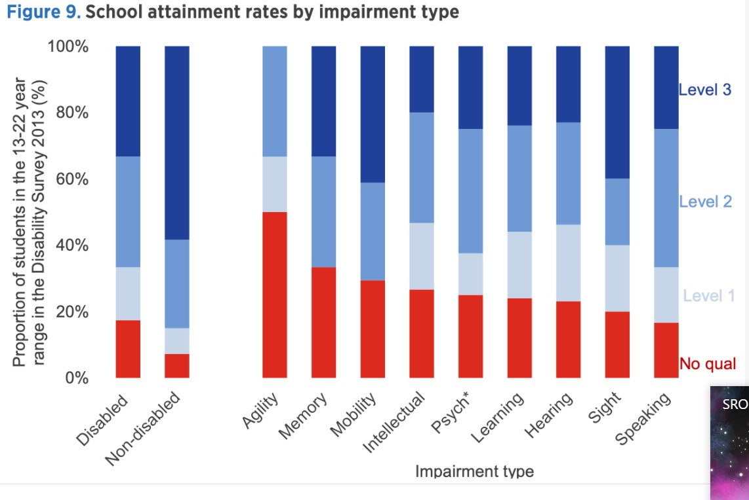
Opportunity: education
Some data is available at a sub- disability level
Attainment levels for high school qualifications are significantly lower for people with disabilities e.g., 20- 30% vs ~5-10% for the general population

Slide 14
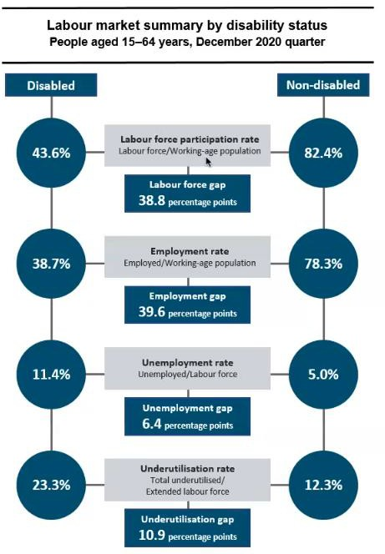
Opportunity: employment
Good quality employment data exists at a disability level but not sub-disability
Unemployment rate for disabled population is ~double that of the non-disabled population
Underutilisation rate is also higher (people who would
like to be in more employment but aren’t)
A higher proportion of the disabled population opt out of
the labour force.
A large portion of non-participation is older people with age-related physical disabilities

Slide 15
Data insights
 | Impact | Quality | Opportunity | Population | Cost
Inputs to this SROI | ImpactLab’s library of quantified impacts | Family case studies and 2 interviews with parents Review of The Champion Centre research base and global literature | NZ disability population rates for employment, risky behaviour, addiction and child placement ID disability rates used for mental health and education |  | The Champion Centre operational data
Key assumptions | ‘Lifetime’ impact is conservatively valued over a 5-year period | Literature is analogous to this programme | 100% eligibility for child physical health and caregiver mental health | Participants were divided into age groups for which different impacts bundles were applied
Potential levers to grow understanding of impact | Unpack longitudinal outcomes for children with disabilities without support Disaggregate vulnerability levels Build view of downstream system health costs | School stage outcomes Advocacy and referral data outside pf psych esp health referrals (e.g., dietician, feeding clinic) Could family planning goals and feedback be systematically captured to demonstrate effectiveness? | Increase visibility of social context for families e.g., parental employment status | Understand length of engagement per child

Slide 16
Key takeaways
Drivers of high social value per person:
Effectiveness: model is highly evidence-based
Outcomes: The difference between pathways with and without support can be significant, particularly for families facing pre-existing challenges in the home environment
Population:
support is provided to the whole family unit
family engagement levels are high and long-term, but also with a clear outwards transition point
Reasons social value is likely to be undercounted:
Intrinsic benefits of improved physical health have been captured (applying NZ Treasury social wellbeing methodology)
but ‘hard costs’ to health system of improved health for children is likely understated
Benefits of improved education outcomes have been captured, but not the additional education system costs where children enter the school system without support
Lifetime impact is conservatively estimated as a 5-year value. Given the lifelong nature of disabilities, impact is likely to far
exceed this window.
It is difficult to break down long-term impact at a sub-disability level but impacts may be significantly higher for some children
There may be opportunities to both improve use of public data to connect to impact for The Champion Centre’s
families, and to collect data at the The Champion Centre to more fully demonstrate impact.

Slide 17
Social value breakdown
Total cost |  | $2,277,118
Total social value |  | $2,539,310
SROI (social value as proportion of programme cost) |  | 110%
# children completing | 70
Social value per child completing | $36,276

Slide 18
The Champion Centre
Doing good, better.

